Slide 1

MINOR PROJECT PRESENTATION
Emotion Classification based on Hinglish text
Submitted to Manipal University, Jaipur
Towards the partial fulfilment for the Award of the Degree of
BACHELORS OF TECHNOLOGY
In Information Technology
2018-2022
Guided by:
Mr. Ankit Mundra
Department of Information Technology School of Computing and Information Technology
Manipal University Jaipur Jaipur, Rajasthan
Made by:
Siddhant Bhanot (189402111)
Sagar Rajput (189303154)

Slide 2
Motivation
This project aims at classifying social media Hinglish text based on aggression into 3 classes namely NAG(Non Aggressive), CAG(Covertly Aggressive) and OAG (Overly Aggressive).
With the increase in hate speech, it is important to classify social media text in order to remove and report the text which is not suitable from the social media platform and thus control hate speech.
Usage of code switched language like Hinglish has increased on the social media platform.
However classifying up of such sentences is a challenge due to grammar and spelling variations.
This project aims to build a working ML model with a good accuracy to classify such sentences.

Slide 3
Collection of Dataset
Creating an authentic dataset was a limitation. Because of this we needed an already authenticated and published dataset for the same.
TRAC 2 dataset was chosen which was published by the European Language Resources Association in Language Resources and Evaluation Conference(2020).
About the dataset
The dataset consisted of 5,000 aggression-annotated data from social media each in Bangla (in both Roman and Bangla script), Hindi (Roman) and English for training and validation.
For our project, only Hindi corpus (written in roman script) is needed.

Slide 4
Conversion of data into Devanagari script
Given the Hinglish data was written in roman script, we needed to translate(and or transliterate) the data into devanagari script.
Google translate api and indic_trans library were used for the above task.

Slide 5
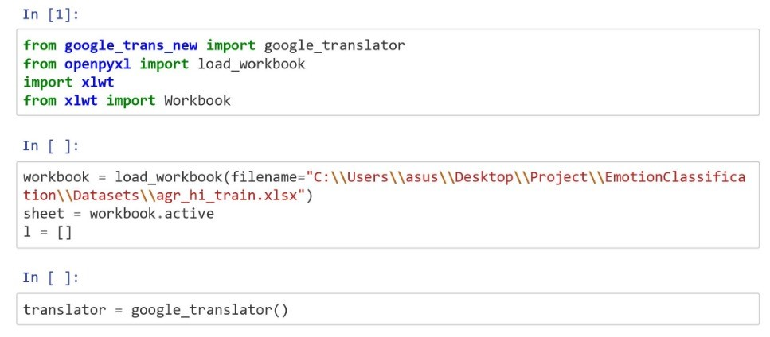
Google-Trans:

Slide 6
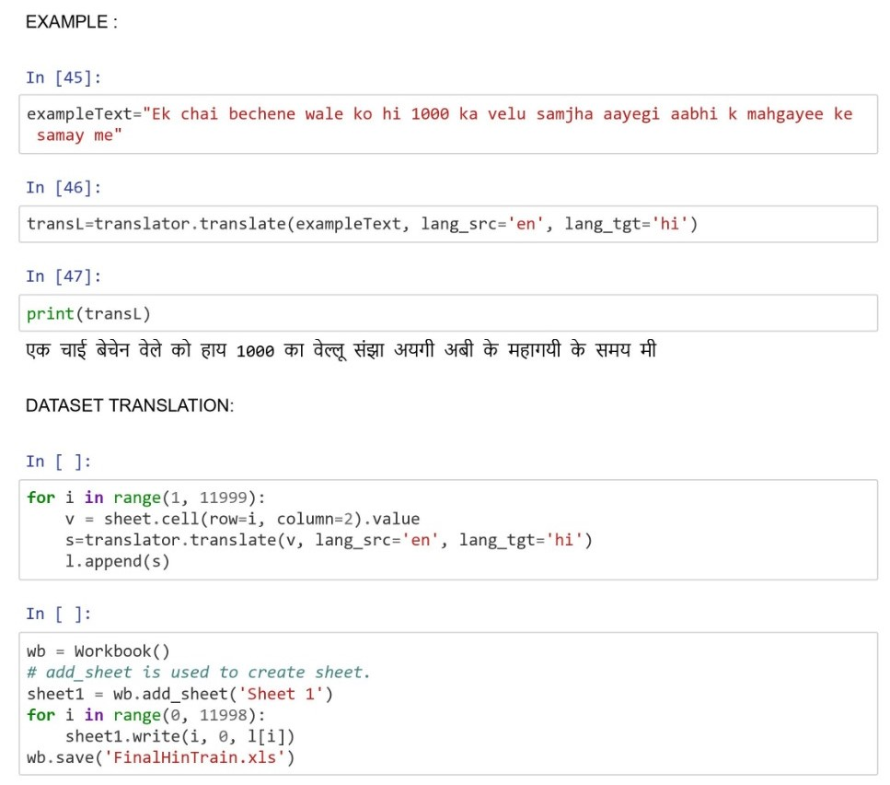

Slide 7
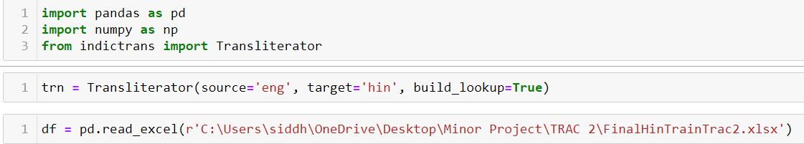
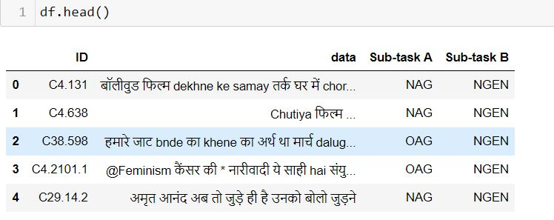
INDIC-TRANS :

Slide 8
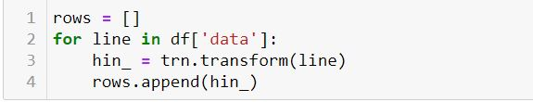
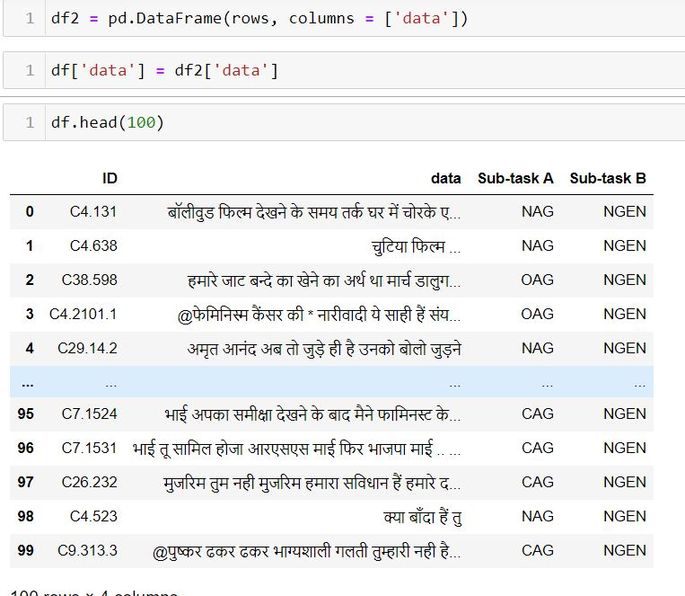

Slide 9
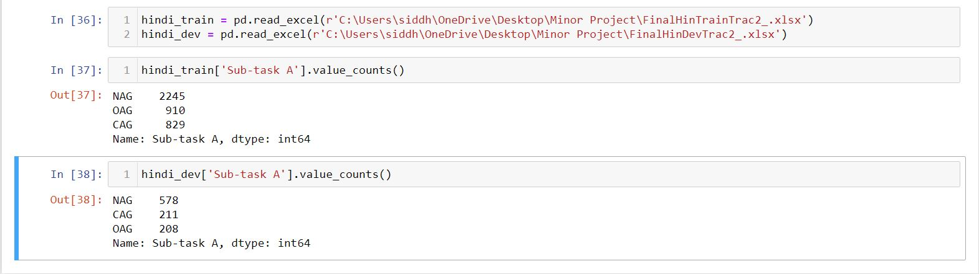
Imbalanced dataset
The hindi dataset was divided into two parts namely hindi_train and hindi_dev.
The distribution of the two datasets was as follows :-
The imbalances may result into biased classification, and hence it was needed to rectify it.
In order to balance the dataset, text augmentation approach was applied which not only helped in balancing the dataset but also increased the size.

Slide 10
Text Augmentation
What is text augmentation ?
It is the process of artificially extending a set of existing data by performing on them some operations which depend on the data type. The goal is to create new labeled data from the existing ones
There are different techniques for text based data augmentation. One process includes 4 techniques (Jason Wei et al, 2019) namely - Synonym replacement(SR), Random Insertion(RI), Random Swap(RS), Random Deletion(RD).
Synonym Replacement (SR) - Randomly choose n words from the sentence that are not stop words. Replace each of these words with one of its synonyms chosen at random.
Random Insertion (RI) - Find a random synonym of a random word in the sentence that is not a stop word. Insert that synonym into a random position in the sentence
Random Swap (RS) - Randomly choose two words in the sentence and swap their positions
Random Deletion(RD) - Randomly remove each word in the sentence with probability p
Another popular study generated new data by translating sentences into French and back into English (Yu et al., 2018) which is known as back translation.

Slide 11
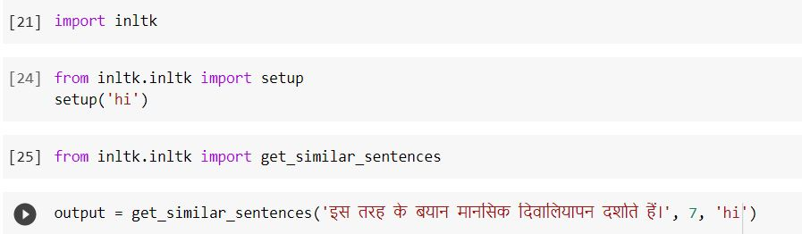
Text augmentation could be performed using iNLTK library (which is the Indian language equivalent of the popular NLTK Python package) using its get_similar_sentences inbuilt library.
However it was seen that, due to high noise in the text data, iNLTK library performed poorly.
Because of this a different approach of back translation using google translate api was chosen which gave comparatively better results.

Slide 12
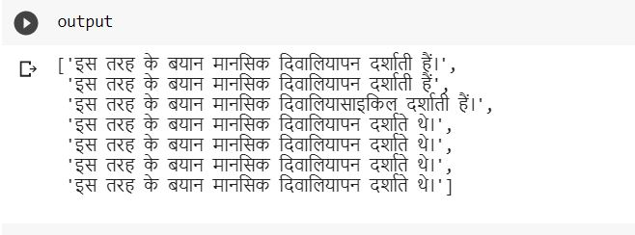
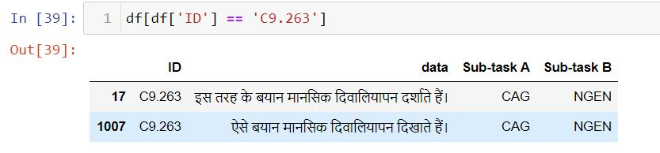

Slide 13

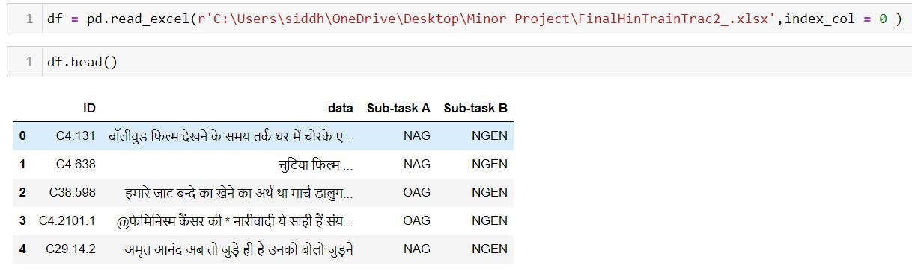
Back translation code using google translate api

Slide 14
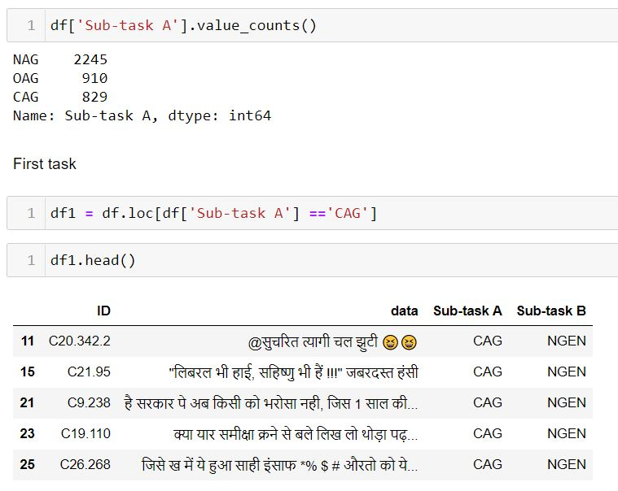

Slide 15
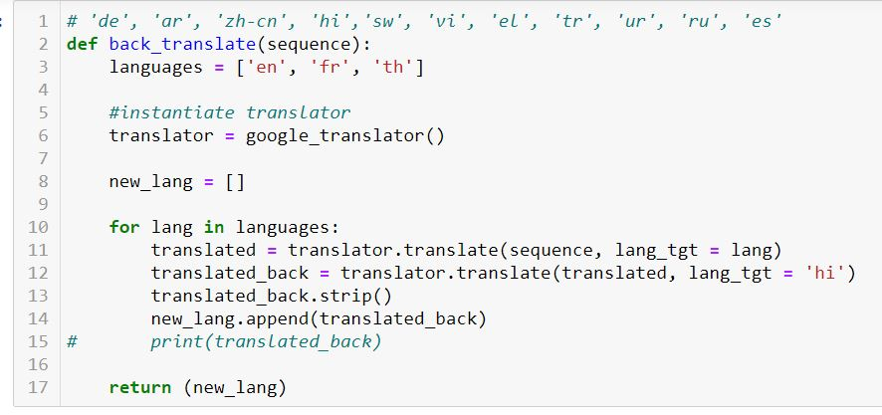

Slide 16
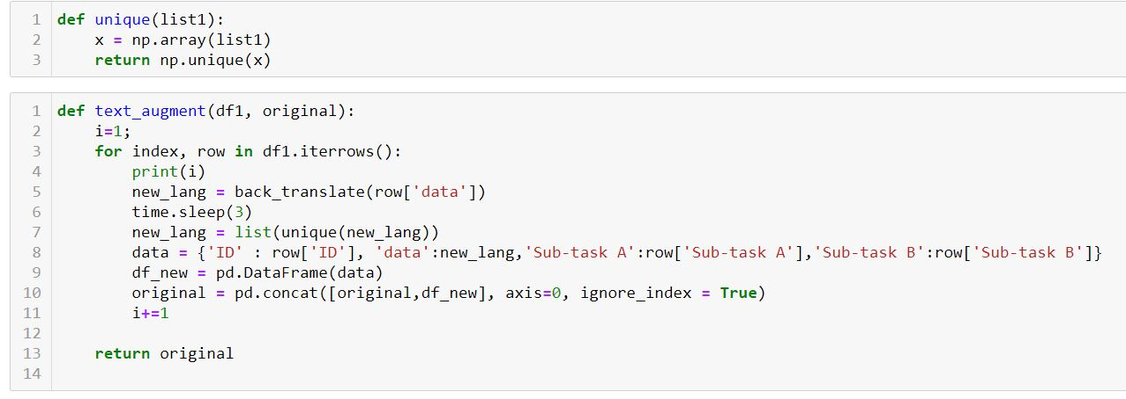

Slide 17
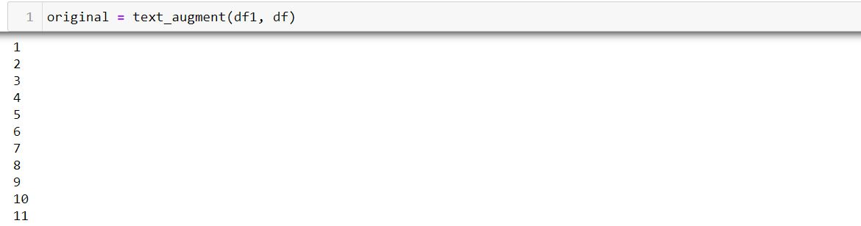
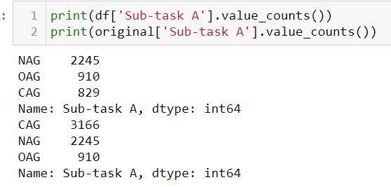

Slide 18
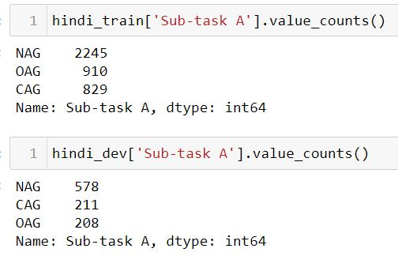
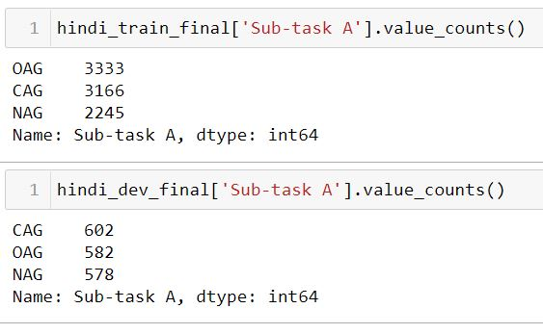
Final distribution of the dataset
Fig 1: Initial distribution
Fig 2: Final distribution

Slide 19
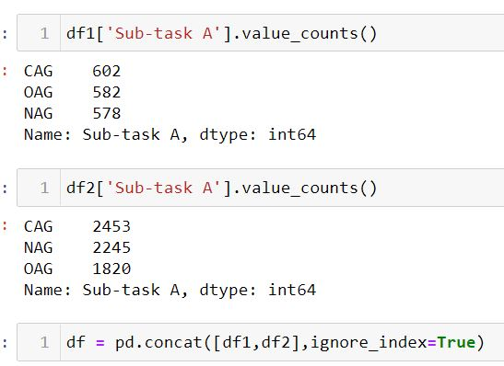
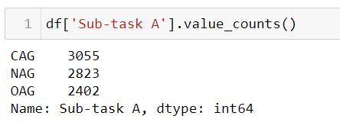
Baseline model
With the prepared dataset, we have implemented 3 baseline ML models which are SVM, XG Boost and Logistic Regression with TF-IDF.

Slide 20
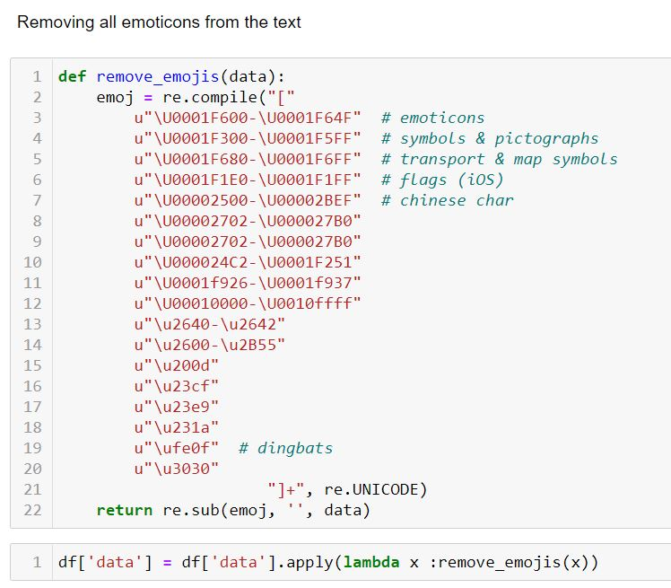

Slide 21
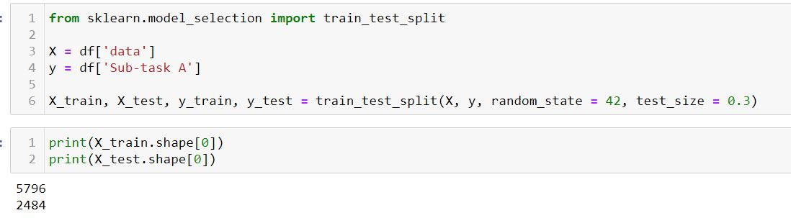
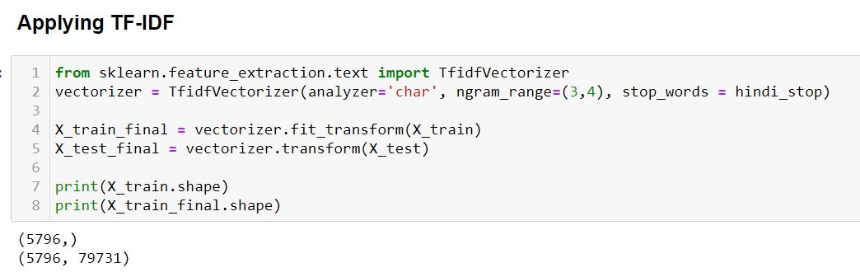

Slide 22
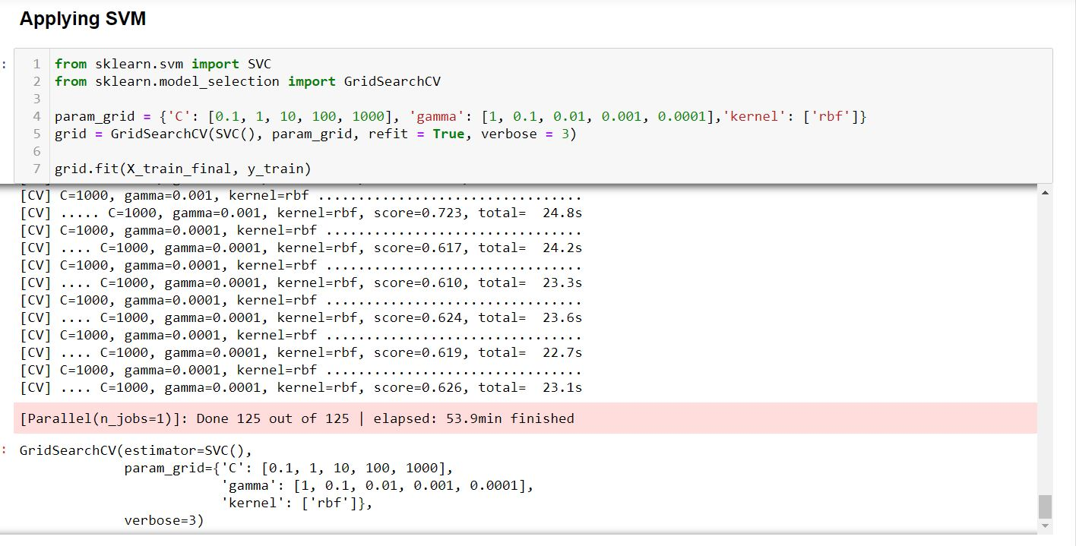

Slide 23
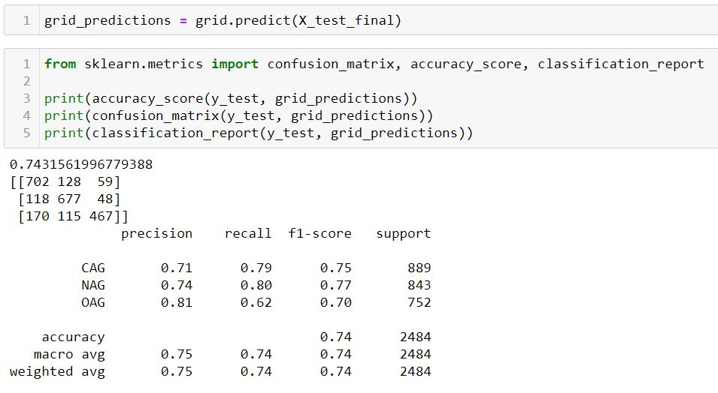

Slide 24
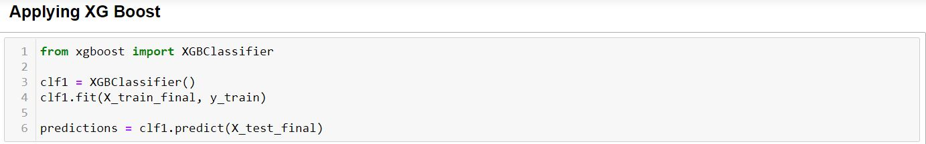
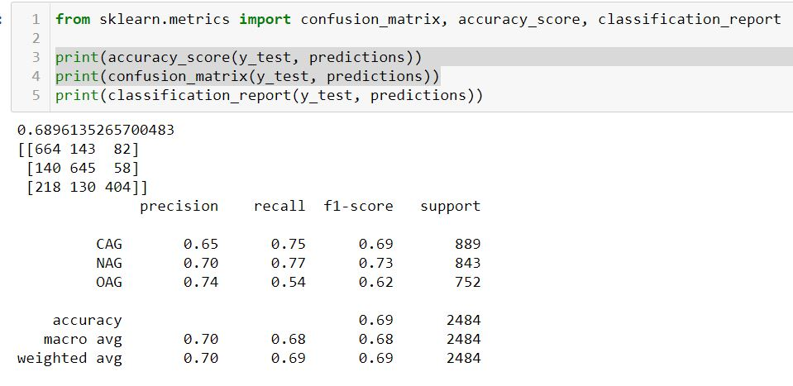

Slide 25
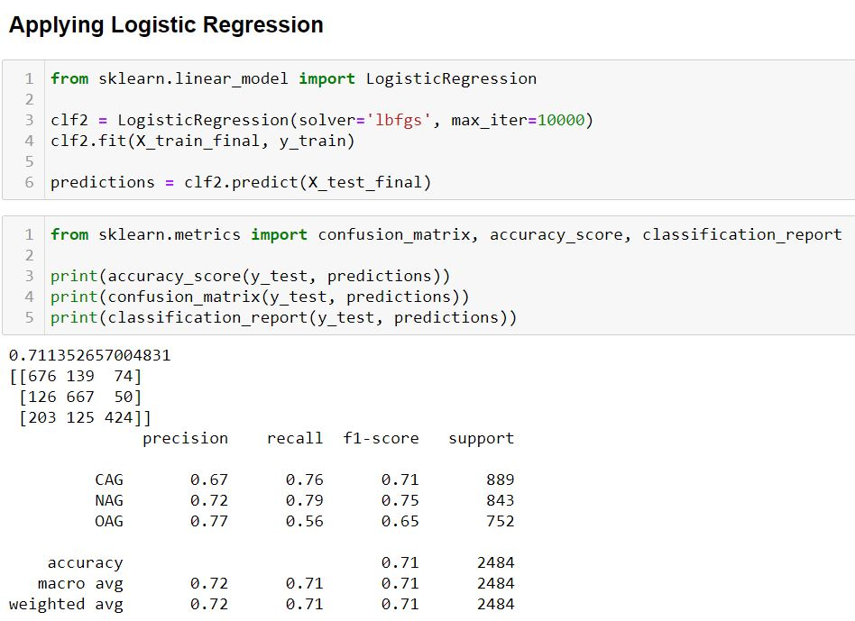

Slide 26
Final approach
The experiments done by Md Abul Bashar et al, 2020 (Misogynistic Tweet Detection: Modelling CNN with Small Datasets) shows that a deep neural network model built on word vectors pre-trained on the task-specific unlabelled(or labelled) dataset is more effective than built on word vectors pre-trained on a sizeable general corpus when the dataset available is comparatively small.
Following this approach, we chose to convert our data into devanagari so that a pre trained Hindi word vector can be used with a model based on deep neural network.

Slide 27
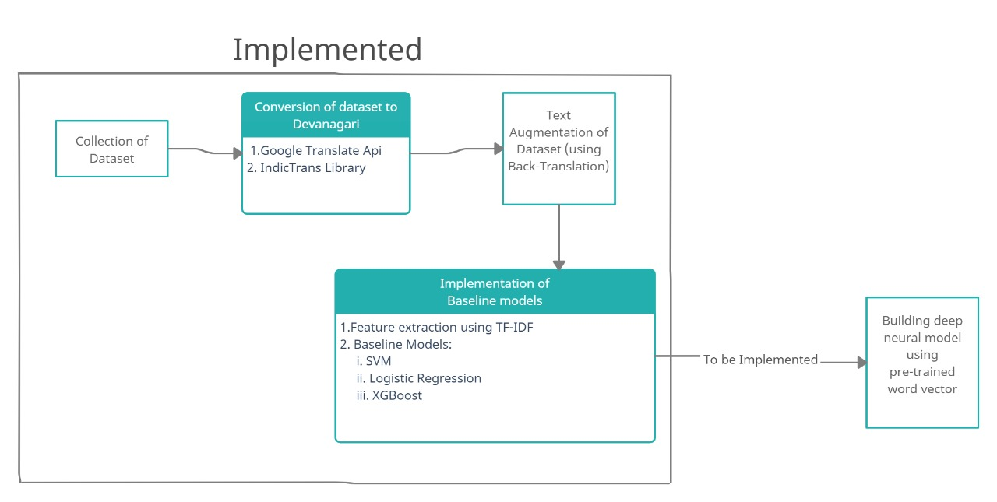

Slide 28
References
TRAC 2 dataset, {Bhattacharya, Shiladitya and Singh, Siddharth and Kumar, Ritesh and Bansal, Akanksha and Bhagat, Akash and Dawer, Yogesh and Lahiri, Bornini and Ojha, Atul Kr.}, https://www.aclweb.org/anthology/2020.trac2-1.25
Jason Wei and Kai Zou, 2019. EDA: Easy Data Augmentation Techniques for Boosting Performance on Text Classification Tasks, arXiv:1901.11196
Adams Wei Yu, David Dohan, Minh-Thang Luong, Rui Zhao, Kai Chen, Mohammad Norouzi, and Quoc V. Le. 2018. Qanet: Combining local convolution with global self-attention for reading comprehension. arXiv:1804.09541
Md Abul Bashar, Richi Nayak, Nicolas Suzor and Bridget Weir, 2020. Misogynistic Tweet Detection: Modelling CNN with Small Datasets. arXiv:2008.12452

